Slide 1
Welcome to Physical Science
Mrs. Holland
Mrs. Noack

Slide 2
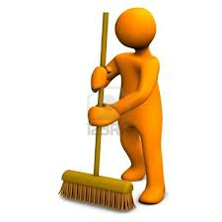
Joke of the Day:
Why did the broom get a poor grade in school?
What’s the king of all school supplies?

Slide 3
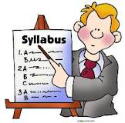
Syllabus
Due back signed by Friday: 1st Homework Grade
You must sign
Parent/guardian must sign
In order to sign it you must have read it and understand what is expected of you.
Possible Syllabus Mini-Quiz Friday

Slide 4
Lab Safety
Due back signed by Friday: 2nd Homework Grade
You must sign
Parent/guardian must sign
In order to sign it you must have read it and understand what is expected of you.
Lab Safety Quiz Next Week (Thursday?)
You will not be able to participate in
classroom labs until this is signed.

Slide 5
Notecards
Front of the Notecard
1). Name
2). Preferred Name
Preferred Guardian Contact Information.
Email or Telephone
Back of the Notecard
3 Fun Facts About You
Ideas: Hobbies, Talents, Favorite Food, etc..
BE CREATIVE!!

Slide 6
Get To Know You Activity
Guess that person
1). I will read off one of the fun facts on the notecard
2). If that fact describes you stay standing, if it does not sit down.
Exp: “My favorite color is Blue”
Stay Standing if your favorite color is blue.
Sit down if your favorite color is NOT blue.
3). Repeat with other facts until we guess the person

Slide 7
What are the 2 most important things you took away from the Syllabus
Question of the Day

Slide 8
What are the 2 most important things you took away from the Lab Safety Contract?
Question of the Day

Slide 9
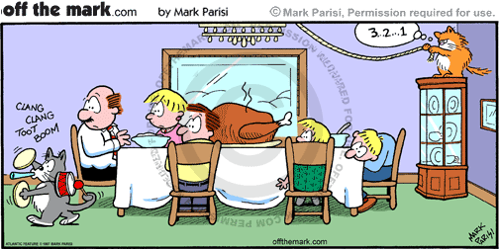
Cartoon:

