Slide 1
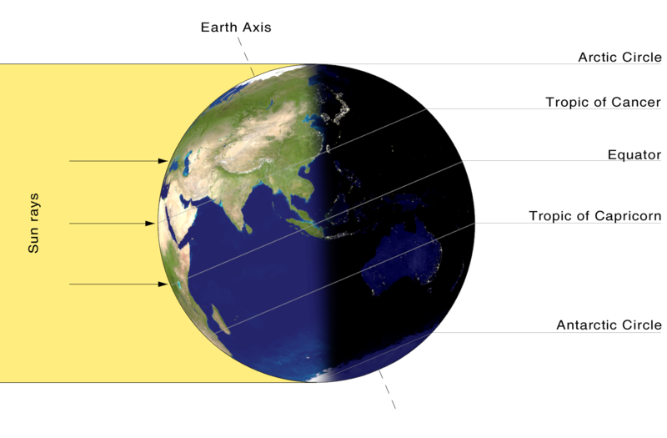
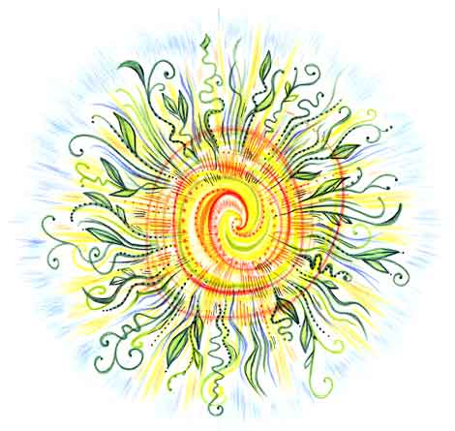
Introduction Into Meteorology
9/22/2011

Slide 2
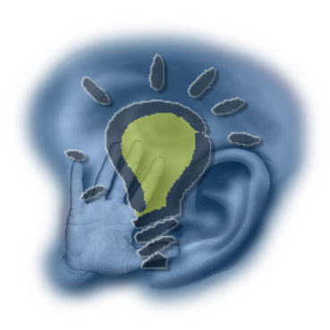
Student Learning Objectives
1). Students will be able to describe what happens during a solstice and equinox.
2). Students will know how the Earth’s tilt causes during solstices and equinoxes causes changes in seasons.
3). Students will understand the difference between direct and indirect sunlight.

Slide 3
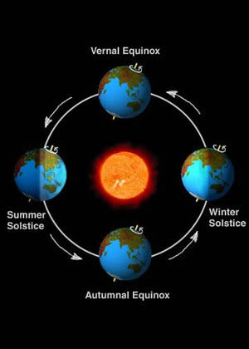
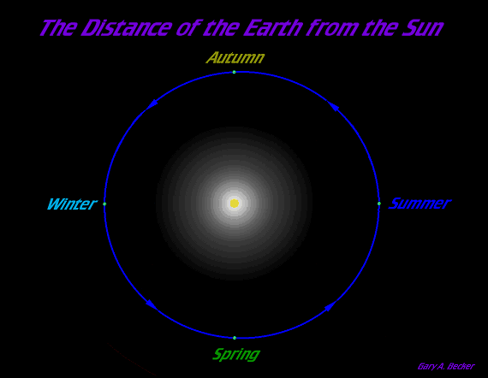
What does the Earth’s orbit around the Sun really look like?
Actual Orbit is Almost Perfectly Circular

Slide 4
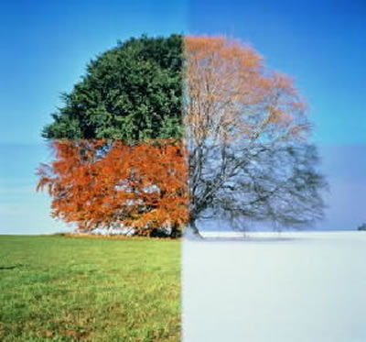
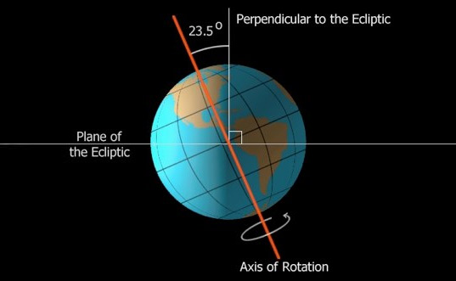
If the Earth’s orbit around the Sun is the same, then how do we get seasons?
What Causes Seasons?
Earth’s Tilt On Its Axis
23.5 Degree

Slide 5
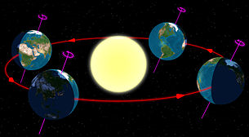
Solstice: “Sun Stands Still”
Summer Solstice
Winter Solstice
June 21st
When the Northern hemisphere of Earth is tilted 23.5 degrees toward the Sun
longest day and shortest night of the year
December 22nd
When the Northern hemisphere of Earth is tilted 23.5 degrees away from the Sun
shortest day and longest night of the year

Slide 6
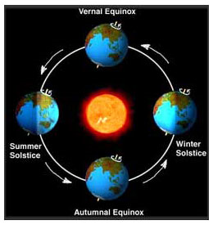
Equinox: “Equal Night”
Autumnal/Fall Equinox
Vernal/Spring Equinox
When Earth is not tilted away from or toward the Sun.
September 22nd
Equal Day and Night
When Earth is not tilted away from or toward the Sun.
March 21st
Equal Day and Night

Slide 7
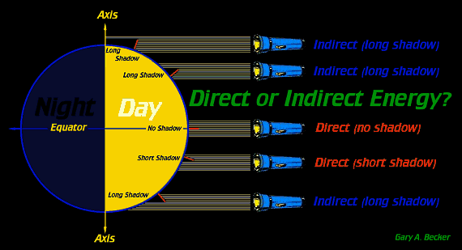
How Does The Earth Having A Tilt Effect Seasons?
Direct Light
Indirect Light
90 Degree Angle
More Concentrated
Passes Through Less Atmosphere
Over 90 Degree Angle
Less Concentrated:
Spread over greater distance
Passes Through Much more Atmosphere

